Slide 1
Urinary Calculi
Murtadha Almusafer
Prof. & Consultant of Urology
University of Basrah – College of Medicine
2021 - 2022

Slide 3
Anatomical Landmarks

Slide 5
Objectives:
-Identify the main risk factors.
-Impact of COVID-19 on patients with urinary calculi
-Know the types of urinary calculi.
-Diagnose by (history, physical examination, investigations, imaging) & know different methods of treatment & recognize those patients with urinary calculi who need urgent intervention due to complications.
-Know how to prevent stone recurrence.

Slide 6
You should Know
1. The emergent & non-emergent conditions
2. Impact of COVID-19 on patients with urinary calculi

Slide 7
Aetiology & risk factors
1.Dietetic: High energy-dense diet may increase the incidence of urinary calculi.
High sodium intake and vitamin A deficiency also increase the incidence of urinary calculi.
2. Altered urinary solutes and colloids: Dehydration & reduction of urinary colloids which adsorb solutes
3.Decreased urinary citrate

Slide 8
4. Urinary infection with urea-splitting bacteri: Streptococci,Staphylococci and especially Proteus spp.
5.Inadequate urinary drainage and stasis
6.Prolonged immobilization
7.Hyperparathyroidism
8. Occupation: Patients with Sedentary works have higher incidence of urinary stones.

Slide 9
9. Climate: Individuals living in a hot climate are more prone to dehydration
which increase the incidence of urinary stones.
10. Family history: also increase its incidence.
11. Medications: as Indinavir, and triametrene.
12. Structural and anatomical abnormalities of the urinary tract.

Slide 10
Stone Varieties
1- Calcium calculi:
It accounts for 85% of urinary stones. it includes calcium oxalate and calcium
phosphate calculi.
2-Uric Acid Stones
-It accounts for less than 5% of all urinary calculi.
-They are usually formed in male patients with gout, rapid weight loss and those
with myeloproliferative diseases.
-Those patients usually have urinary PH≤5.5
-Pure UA stones are radiolucent

Slide 11
3-Struvite Stones
composed of magnesium , ammonium and phosphate (MAP). It frequently found
& tends to grow in alkaline urine so it is more common in women with recurrent
U.T.I. with urea splitting organisms.
4-Cystine Stones
-usually secondary to inborn error of metabolism.
-Uncommon
-Appear in acidic urine
-They are opaque because they contain sulphur
-Very hard

Slide 12
5-Xanthine Stones
-usually secondary to deficiency of xanthine oxidase enzyme.
-Extremely rare
6) Other rare stones: as Indinavir, Silicate and Matrix stones.

Slide 13
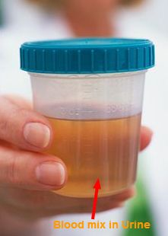
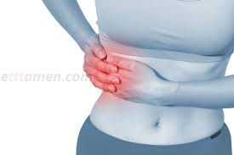
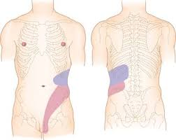
History

Slide 14
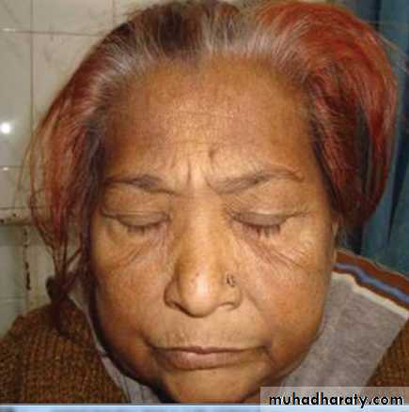
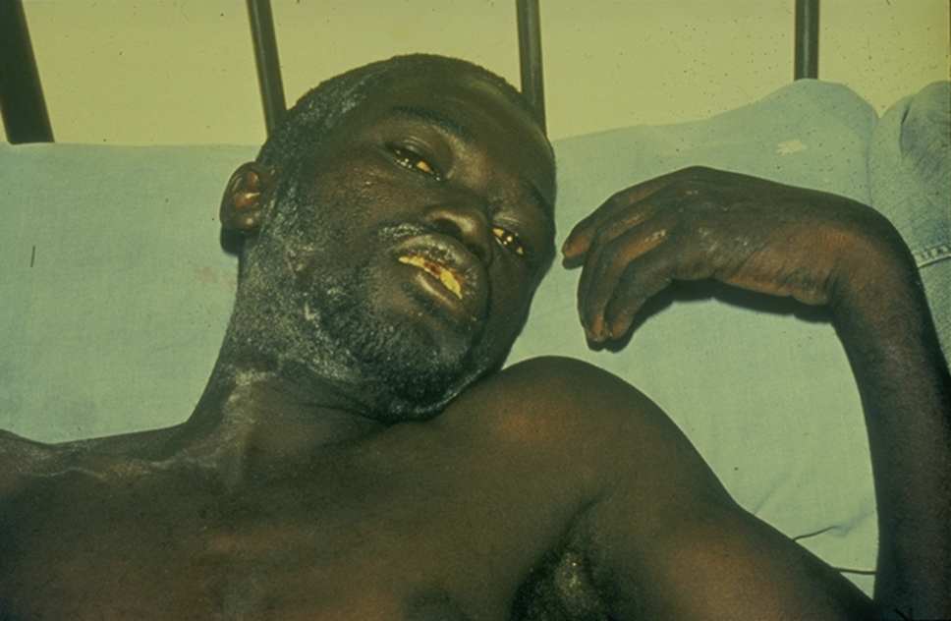
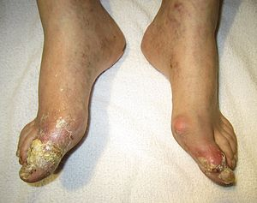
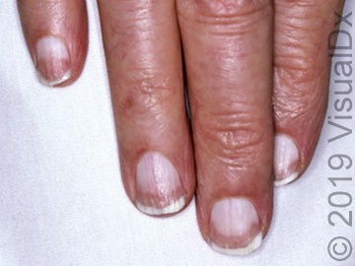
General Examination

Slide 15
Local Examination
Renal
a. Percussion over kidney produces a stab of pain & may be tenderness on deep palpation
b. Palpable loin swelling is rare due to hydronephrosis or pyonephrosis.

Slide 16
Ureteric
During attack of ureteric colic there is rigidity of lateral abdominal muscle but not as a rule, of rectus abdominis.

Slide 17
Vesical
May be normal, there may be suprapubic tenderness.
Vaginal exam.: occasionally large calculus is palpable in female.

Slide 18
Urethral
May be palpable distended bladder due to retention of urine, or palpable urethral stone or showing urethral stone

Slide 19
Bimanual Examination of Kidneys

Slide 20
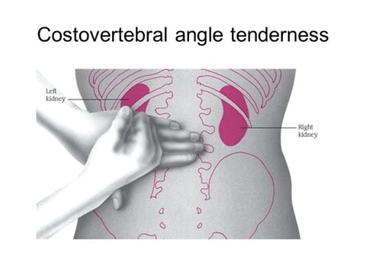
Renal Angle Tenderness (Kidney Murphy Sign)

Slide 21
Investigations
1. Urinalysis (G.U.E.): Look for RBC, WBC, Crystals, and pH.
2. Blood investigations: as B.urea, S.creatinine.
Imaging studies include:
1.K.U.B.: To look for radio opaque shadows. About 90% of renal stones are radio-opaque.
The most radiolucent stones are pure uric acid stones, pure cysteine stones and matrix stones.

Slide 22
2. I.V.U.(EU): to look for filling defects and give an idea about the renal function.
3. Abdominal ultrasound
4. CT-scan: helical CT-scans are now the imaging modality of choice for patients
presenting with acute ureteric colic,
While M.R.I. is a poor study for documentation of urinary stones.
5. Nuclear scintigraphy.

Slide 23
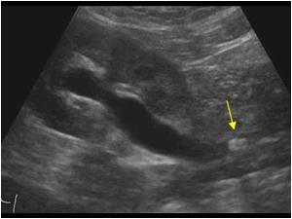
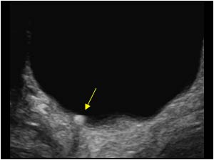
Ultra-sonography

Slide 24
X-Ray characteristic

Slide 25
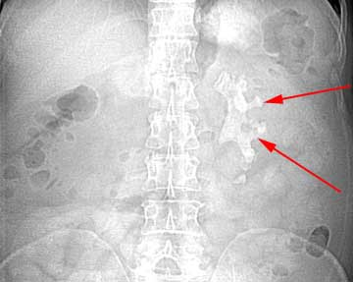
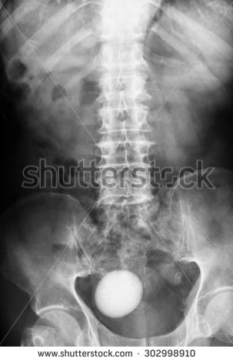

Slide 26
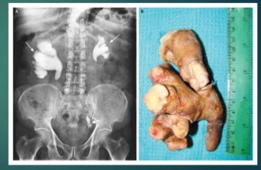
Staghorn Renal Stones

Slide 27
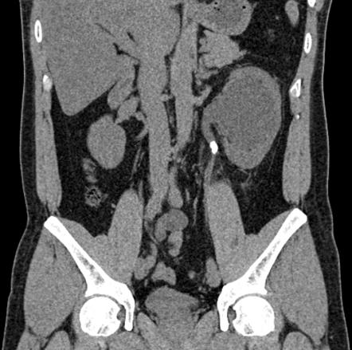
CT

Slide 28
TRT
Conservative TRT
a. Increase fluid.
b. Dissolution agents: oral alkalinizing agents which include Na or K bicarbonate and k citrate.

Slide 29
TRT of Acute Pyelonephritis
A patient with obstructive ureteral calculi with fever ( acute pyelonephritis ) requires: a. Admission: IV line, Urine, & blood culture.
b. I.V fluid, antipyretics, & analgesics.
c. Broad spectrum antibiotics until results of urine C&S
d. Emergent drainage like by placement of DJ stents or P/C nephrostomy.

Slide 30
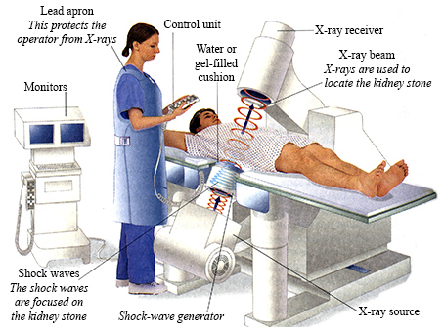
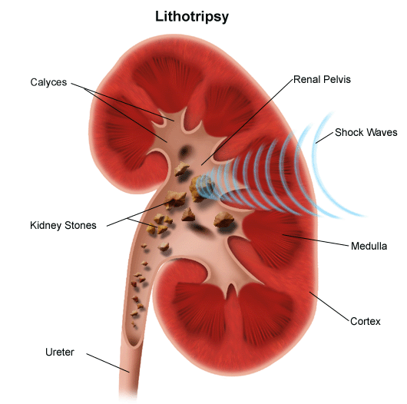
ESWL
It can be considered for those patients with renal stones, size(<25 mm) and those with failed conservative treatment.

Slide 31
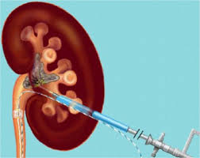
PCNL

Slide 32
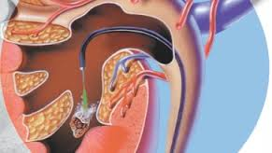
RIRS

Slide 33
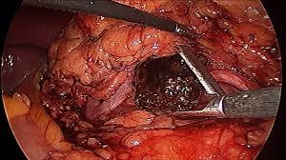
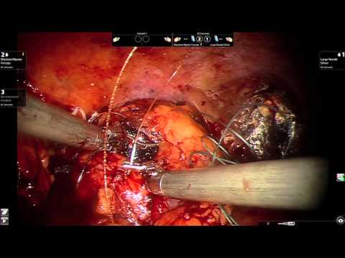
Laparoscopic Surgery

Slide 34
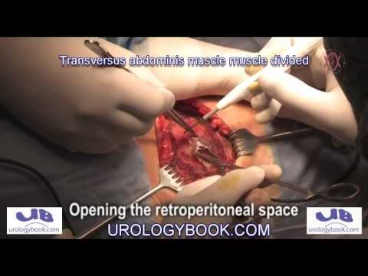
Open Surgery

Slide 35
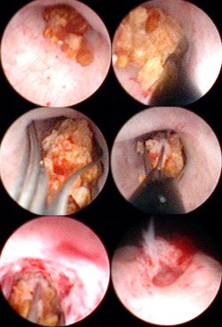
TRT of Ureteric Stones

Slide 37
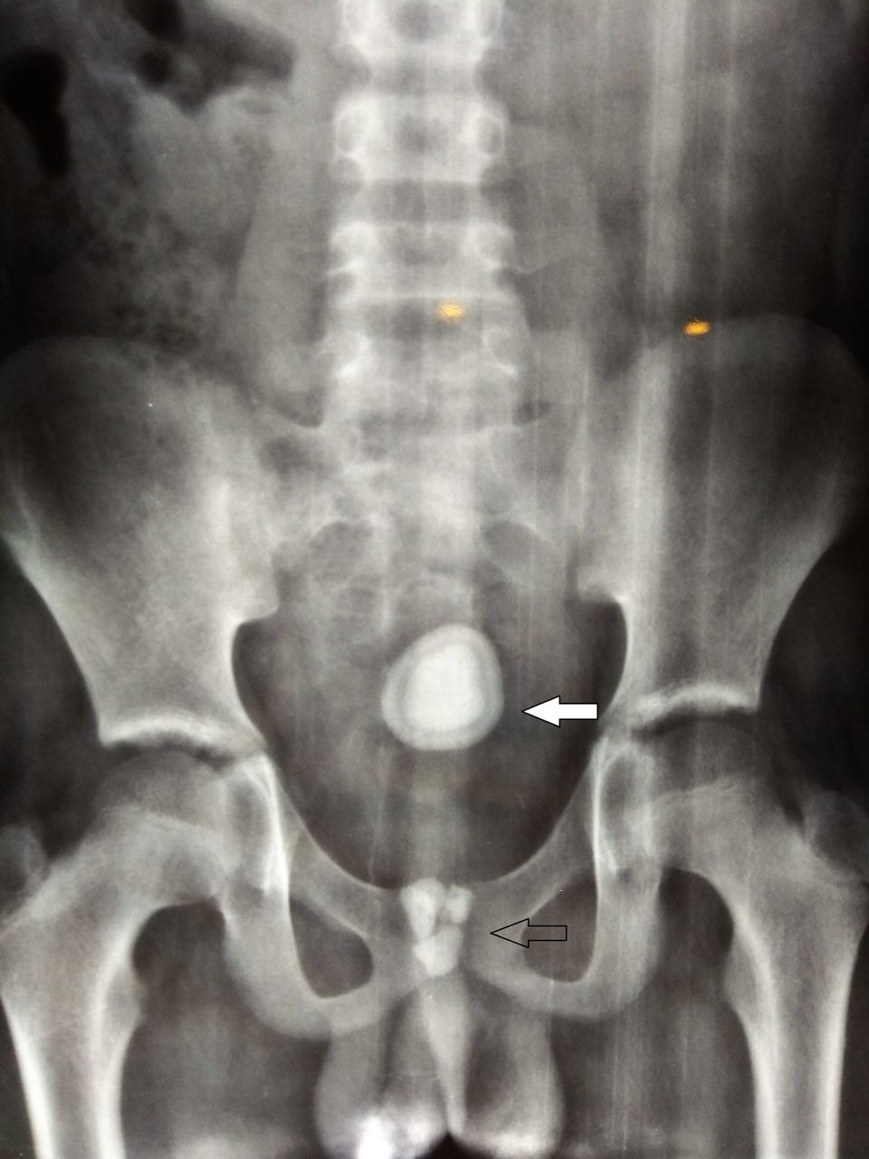
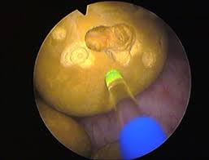
Bladder Stones

Slide 38
Prevention
In bilateral & recurrent stone formers: 1.Serum calcium
2.Serum uric acid
3.Urinary urate, Ca & Phosphate in 24 hr collection,& urine should be screened for cystine.
4. Analysis of any stone passed.
5. Dietary advice
6.Drink plenty of fluid.
7.Drug TRT: Idiopathic hypercalciuria: Bendroflumethiazide 5mg.
Allopurinol & urine alkalinization

Slide 39
Impact of COVID-19 on urinary stones:
1.Homestay with physical inactivity & consequent weight gain
2.Due to fear of visiting outpatient, there will be more incidence of complications and if the patient has DJ stents, there is high incidence of encrustation.

